Slide 1
Design Presentation: Security
Owner: Sean Norman
CSA07P | 1 of 2
Session Day/Time: |  | Presenters/SMEs:
Virtual Format and Software:
Cohort / Breakout Mgmt
Objective of Session: | As a result of attending this, attendees will better be able to…
Existing Sources: | <link to any supporting content sources (if any)>
Learner Content: | <Link to draft ppt slide deck and any other materials that the attendees would be seeing or using as part of this session>
Presenter/ SME Guide Content: | <Link to any supporting materials that are just for the presenter and/or supporting SMEs>
Required Homework + name of session for HW review: | No homework or pre-required content needed for this session

Slide 2
Design Presentation: Security
Owner: Sean Norman
CSA07P | 2 of 2
Session Flow and Detailed Agenda |  | Presenter/SME: | Time
Prework | No attendee pre-work needed for this session | N/A | N/A
Session Introduction | Set context for when this process takes place | <presenter> | 3 mins
Body of the session / discussion, activities, Q&A... |  | <presenter> | 25 mins
Session Closing / Homework |  | <presenter> | 2 mins

Slide 3
Topics Covered
Security Secure an Azure Synapse workspace
Security baseline
Network security

Slide 4
Security in Azure Synapse

Slide 5

Agenda
1 Security baseline
Synapse Analytics security baseline
2 Network security
Synapse Managed Virtual Network and Managed private endpoints

Slide 6
Security baseline for Synapse Analytics

Slide 7
The Security Baseline for Synapse Analytics
Contains recommendations that will help you improve the security posture of your deployment
Network security | Protect with VNETs Monitor configuration and traffic of VNETs, subnets and network interfaces Use Advanced Threat Protection (ATP) and DDoS Protection, Record network packets, Use tags for network security groups
Logging and monitoring | Update time synchronization for your compute deployments, Central security log management, Enable auditing on the Azure SQL server-level, Configure security log storage retention, Use advanced Threat Protection (ATP) for Azure SQL Database in conjunction with Azure Security Center to monitor and alert on anomalous activity
Identity and access control | Maintain an inventory of administrative accounts Change default passwords where applicable Use dedicated administrative accounts, Use AAD single sign-on Use multi-factor authentication for all AAD-based access Use a Privileged Access Workstation (PAW) with Multi-Factor Authentication (MFA) configured to log into and configure Azure resources Use Azure Active Directory security reports for generation of logs and alerts when suspicious or unsafe activity occurs in the environment. Manage Azure resources from only approved locations Create an Azure Active Directory (AD) administrator for the Azure SQL Database server in your Synapse SQL pool. Regularly review and reconcile user access In support scenarios where Microsoft needs to access data related to the Azure SQL Database in your Synapse SQL pool, Azure Customer Lockbox provides an interface for you to review and approve or reject data access requests Use Azure Active Directory (Azure AD) Identity Protection and risk detection features to configure automated responses to detected suspicious actions related to user identities. Configure Azure Active Directory (AD) authentication with Azure SQL and enable diagnostic settings for Azure Active Directory user accounts, sending the audit logs and sign-in logs to a Log Analytics workspace. Configure desired alerts within Log Analytics

Slide 8
Security Baseline for Synapse Analytics
Contains recommendations that will help you improve the security posture of your deployment
Data protection | Maintain an inventory of sensitive Information; Isolate systems storing or processing sensitive information; For any Azure SQL Database in your Synapse SQL pool storing or processing sensitive information, mark the database and related resources as sensitive using tags. Configure Private Link in conjunction with network security group (NSG) service tags on your Azure SQL Database instances to prevent the exfiltration of sensitive information. Encrypt all sensitive information in transit. Use the Azure Synapse SQL Data Discovery & Classification feature. Data Discovery & Classification provides advanced capabilities built into Azure SQL Database for discovering, classifying, labeling & protecting the sensitive data in your databases. Use RBAC to manage access to Azure SQL databases in your Synapse SQL pool Encrypt sensitive information at rest: use TDE (Transparent data encryption); Log and alert on changes to critical Azure resources (Azure Monitor : Activity Log and alerts on Synapse in the Azure portal)
Vulnerability management | Run automated vulnerability scanning tools; Compare back-to-back vulnerability scans (Vulnerability Assessment is a scanning service built into Azure Synapse SQL.); Use a risk-rating process to prioritize the remediation of discovered vulnerabilities (Data Discovery & Classification built into Azure Synapse SQL)
Inventory and asset management | Use automated asset discovery solution (Azure Resource Graph); Maintain asset metadata (Apply tags to Azure resources). Delete unauthorized Azure resources. Define a list of approved Azure resources related to your Synapse SQL pool. Monitor for unapproved Azure resources (use Azure Policy and Azure Resource Graph) Use only approved Azure services Any resource related to your Synapse SQL pool that is required for business operations, but may incur higher risk for the organization, should be isolated within its own virtual machine and/or virtual network and sufficiently secured with either an Azure Firewall or Network Security Group.
Secure configuration | Use Azure Policy aliases in the "Microsoft.Sql" namespace to create custom policies to audit or enforce the configuration of resources related to your Synapse SQL pool. You may also make use of built-in policy definitions for Azure Database/Server, such as: Deploy Threat Detection on SQL servers / SQL Server should use a virtual network service endpoint. If using custom Azure Policy definitions, use Azure DevOps or Azure Repos to securely store and manage your code. Implement automated configuration monitoring for Azure resources ( Azure Security Center) Manage Azure secrets securely:TDE; Use Managed Identities to provide Azure services with an automatically managed identity in Azure Active Directory (AD); Implement Credential Scanner to identify credentials within your code
Notes:
https://docs.microsoft.com/en-us/azure/synapse-analytics/security-baseline for more details on the security baseline

Slide 9
Security Baseline for Synapse Analytics
Contains recommendations that will help you improve the security posture of your deployment
Malware defense | Pre-scan files to be uploaded to non-compute Azure resources (Microsoft anti-malware is enabled on the underlying host that supports Azure services. Pre-scan any content being uploaded to non-compute Azure resources, such as App Service, Data Lake Storage, Blob Storage, Azure SQL Server, etc. )
Data recovery | Ensure regular automated back-ups: Snapshots of your Synapse SQL pool are automatically taken throughout the day creating restore points. Periodically test your restore points to ensure your snapshots are valid. Ensure protection of backups and customer-managed keys: By default, data in a storage account is encrypted with Microsoft-managed keys. You can rely on Microsoft-managed keys for the encryption of your data, or you can manage encryption with your own keys. If you are managing your own keys with Key Vault, ensure soft-delete is enabled
Notes:
https://docs.microsoft.com/en-us/azure/synapse-analytics/security-baseline for more details on the security baseline

Slide 10
Network Security in Synapse

Slide 11
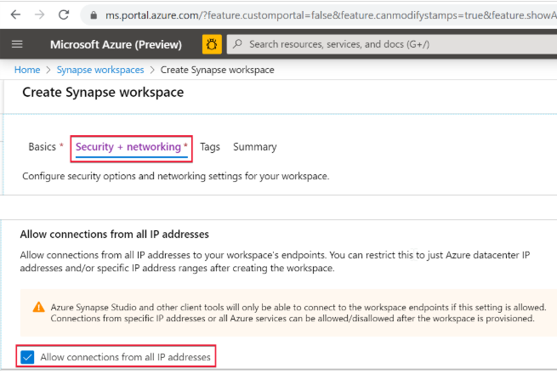
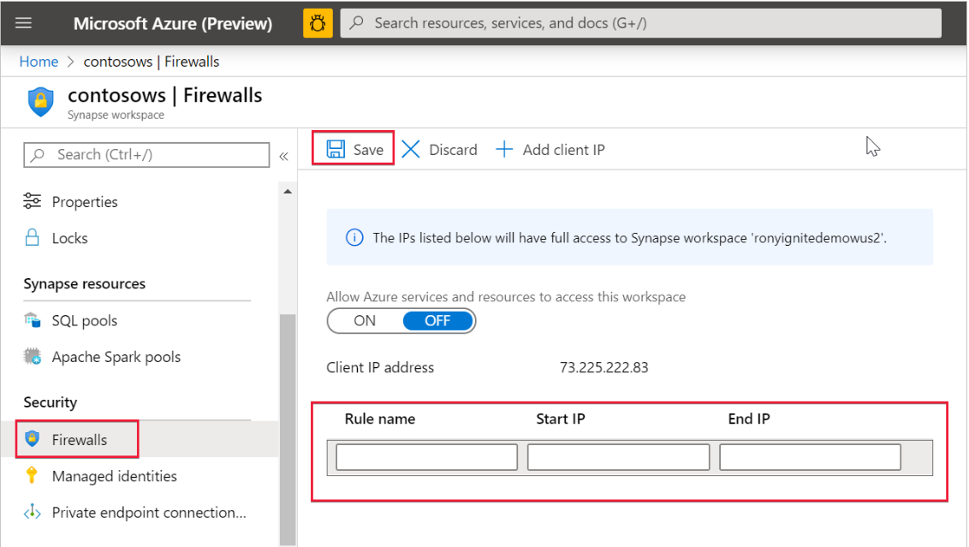
Synapse Workspace IP firewall rules
Select Security + networking and check Allow connections from all IP addresses during workspace creation
OR
(after the workspace is created)
Select Firewalls under Security from Azure portal. To add a new IP firewall rule, give it a name, Start IP, and End IP. Select Save when done

Slide 12
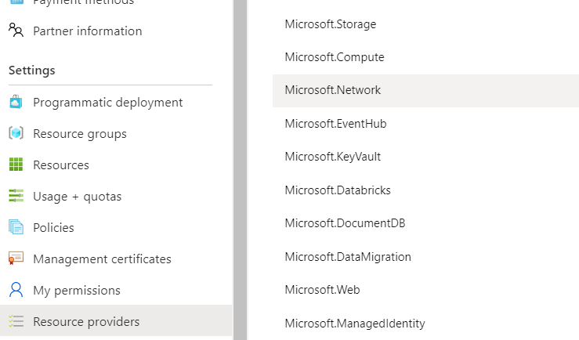
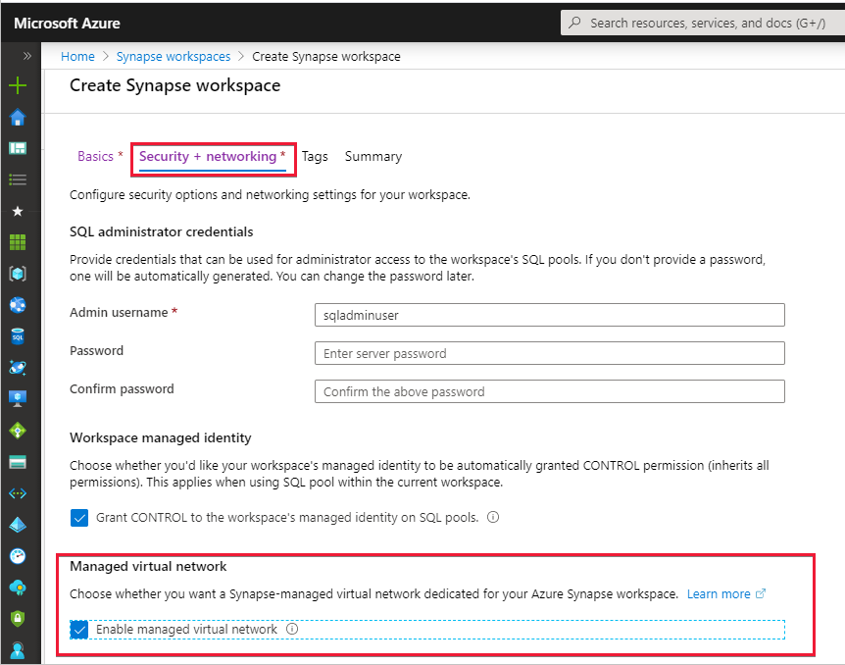
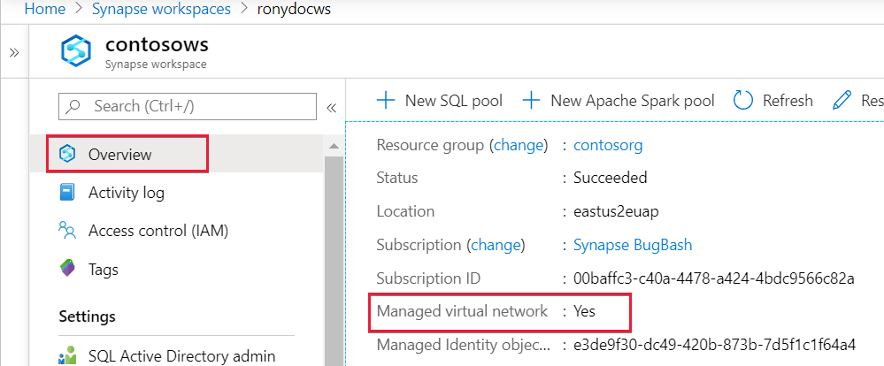
Create an Azure Synapse workspace with a Managed workspace Virtual Network
1. Register the Network resource provider on the subscription: All services: subscription -> select Subscriptions ->select Resource providers -> Microsoft.Network -> Register
(powershell:Register-AzResourceProvider -ProviderNamespace Microsoft.Network)
2. Create a Synapse workspace and Enable Managed Virtual Network
3. Check settings
Notes:
A Managed workspace VNet within Azure Synapse Analytics can only be deployed when you create the Azure Synapse workspace.
When you create your Azure Synapse workspace, you can choose to associate it to a VNet. The VNet associated with your workspace is managed by Azure Synapse. This VNet is called a Managed workspace Vnet.
Benefits
With a Managed workspace Virtual Network you can offload the burden of managing the Virtual Network to Azure Synapse.
You don't have to configure inbound NSG rules on your own Virtual Networks to allow Azure Synapse management traffic to enter your Virtual Network. Misconfiguration of these NSG rules causes service disruption for customers.
You don't need to create a subnet for your Spark clusters based on peak load.
Managed workspace Virtual Network along with Managed private endpoints protects against data exfiltration. You can only create Managed private endpoints in a workspace that has a Managed workspace Virtual Network associated with it.

Slide 13
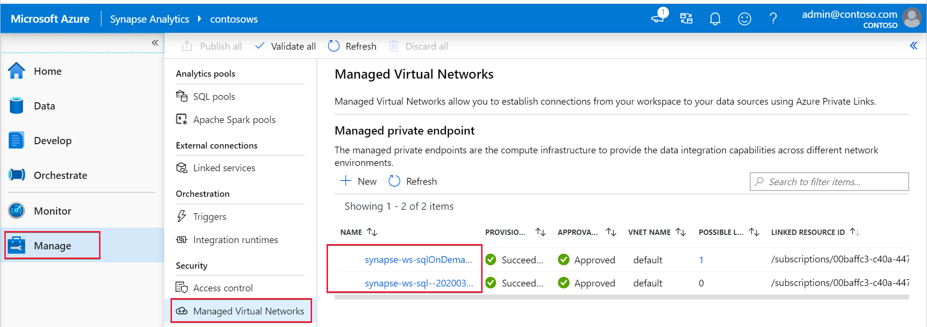
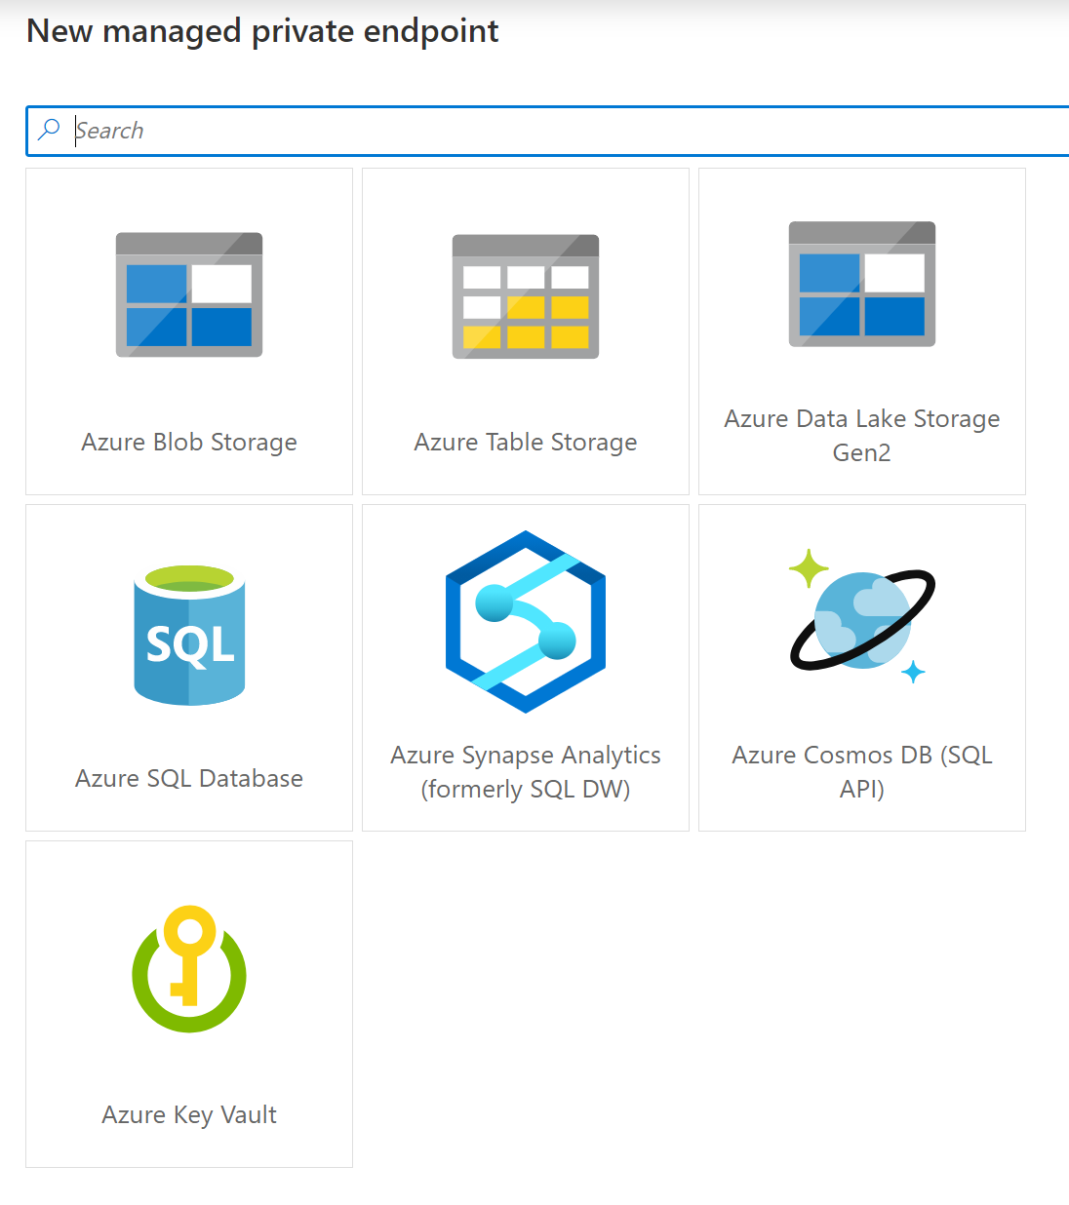
Managed private endpoints for SQL pool and SQL on-demand and other data sources
In the Studio, select Manage in the left navigation, then select Managed Virtual Networks to see the list of managed private endpoints or to add an endpoint to other data sources .
When a workspace is created, Azure Synapse automatically creates two Managed private endpoints to SQL pool and SQL on-demand in that workspace.
Notes:
Managed private endpoints are private endpoints created in the Managed workspace Microsoft Azure Virtual Network establishing a private link to Azure resources. Azure Synapse manages these private endpoints on your behalf.
Only supported in Azure Synapse workspaces with a Managed workspace Virtual Network
Initially created in a “Pending” state in Azure Synapse, initiates an approval workflow, and can be approved/rejected by the Private link resource owner.
Only a Managed private endpoint in an approved state can send traffic to a given private link resource.

Slide 14


Manage VNets in Synapse Workspace
The two Managed private endpoints to SQL pool and SQL on-demand automatically created in Synapse when the Managed workspace VNet is deployed.
Synapse Workspace
Managed VNet
Managed
private endpoint to SQL on-demand
Workspace
SQL on-demand
Synapse Studio
Managed
private endpoint to SQL Pool
Workspace
SQL Pool
Managed private endpoint
Spark Clusters
Other data sources
that support Private Link
(e.g. Cosmos DB,
Azure Storage, ADLS etc.)
The private endpoint establishes a private link between your
Azure Synapse Analytics workspace and your data sources where traffic between your VNet and workspace traverses entirely over the Microsoft backbone network.
IMPORTANT
All outbound traffic from the Managed workspace VNet will be blocked in the future. It's recommended that you connect to all your data sources using Managed private endpoints.
Internet

Slide 15
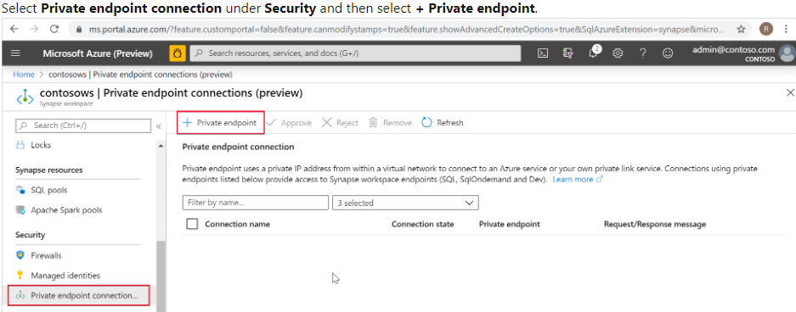

Connecting to Synapse from On-Premise
On-Premise VNet
Synapse Workspace
Managed VNet
SQL On-Demand tenant
*.sql.azuresynapse.net
Managed private endpoint to SQL on-demand
SQL Pool tenant
*-ondemand.sql.azuresynapse.net
Managed PE to SQL Pool
Dev tenant
*.dev.sql.azuresynapse.net
Azure VNET
Subnet
VPN Gateway
Private endpoint
Private endpoint
Private endpoint
site-to-site
point-to-site
Notes:
Check this article to learn how to create private endpoins to your Azure Synapse workspace: https://docs.microsoft.com/en-us/azure/synapse-analytics/security/how-to-connect-to-workspace-with-private-links

Slide 16
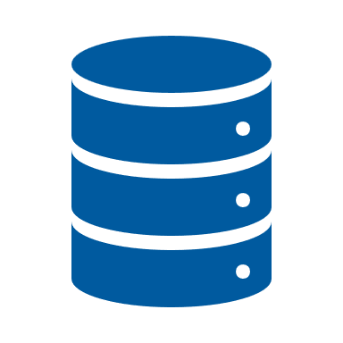
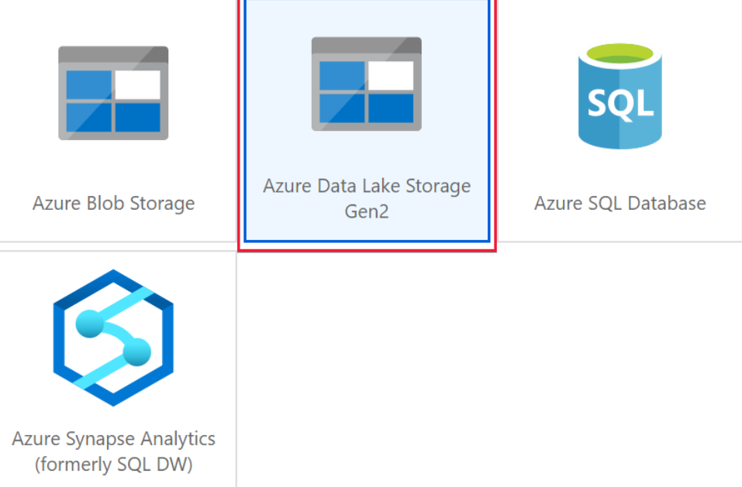
Self-hosted Integration Runtime in Synapse Workspace
Azure Data Factory
*.frontend.clouddatahub.net
Azure ServiceBus
*.servicebus.windows.net
Optional, required when using the staged copy feature
Self-hosted Integration Runtime
(on-premise)
Azure Storage
*.core.windows.net
Optional, required when the Self-hosted integration runtime has auto-update enabled
443
download.microsoft.com
Synapse Workspace
Azure
Integration Runtime
Self-Hosted
Integration Runtime
Managed VNET
Workspace
SQL on-demand endpoint
Synapse Studio
Private endpoint to SQL on-demand
Private endpoint to SQL Pool
Workspace
SQL Pool
endpoint
Private endpoint
Spark Clusters
Supports up to 4 nodes for high availability and scalability
Other data sources
that support Private Link
(e.g. Cosmos DB, Azure Storage etc.)
Internet

Slide 17
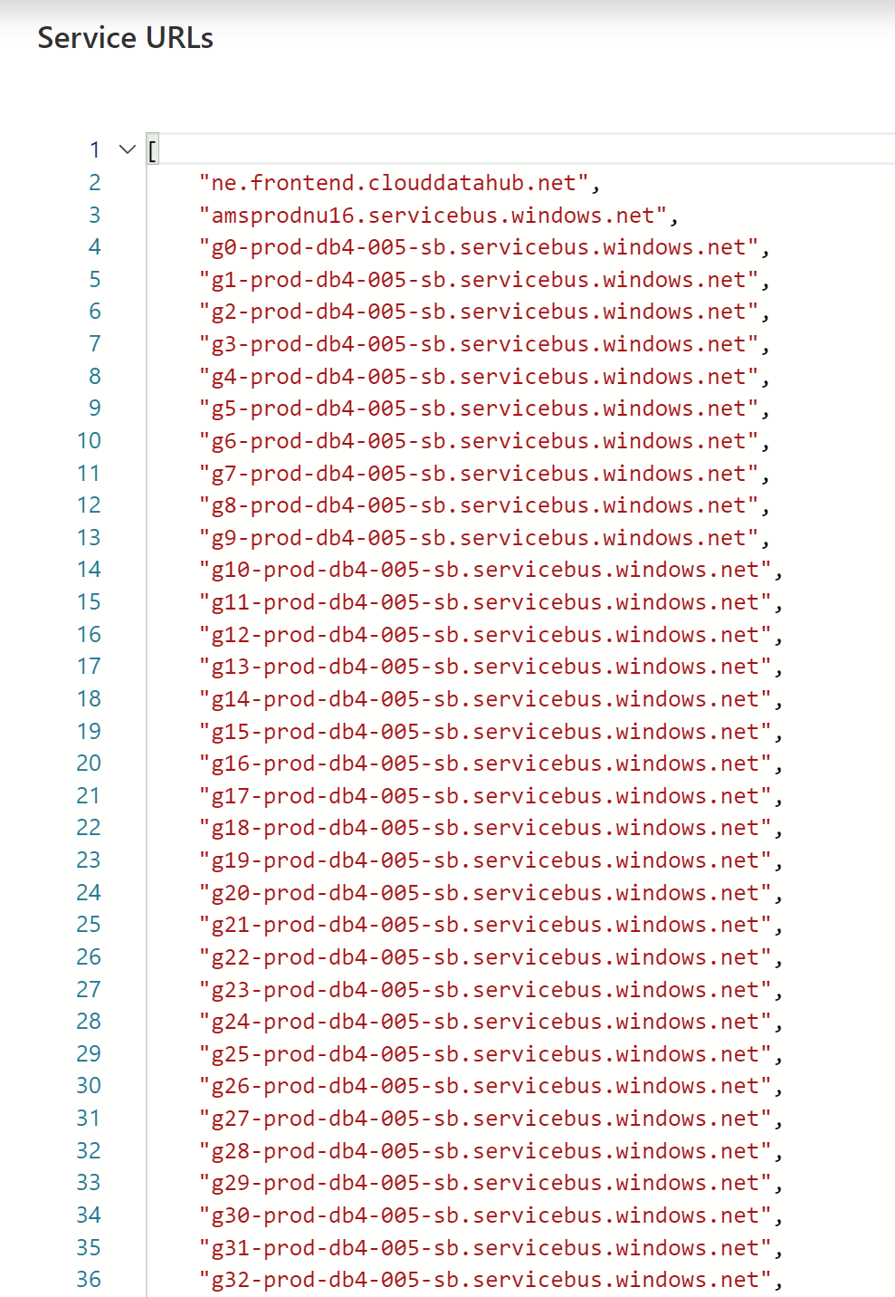
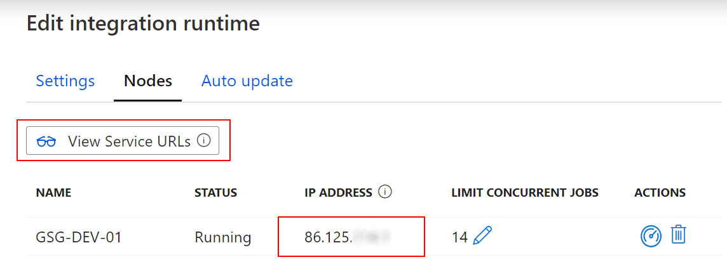
Self-hosted Integration Runtime in Synapse Workspace
Whitelisting of specific public Azure endpoints
Whitelisting of IR-specific IP addresses

Slide 18
Thank You slide
Thank you

